Slide 1


www.eventslay.com

Slide 2



What is the problem?
Staffing Crisis
Last-minute drop out due to family emergencies
Excessive time investment in search for instant staffing solutions
Agencies which overpromise and underdeliver talent
Notes:
Box1: Resolving staffing issues can be quite challenging and finding skilled temporary talent to fill a last-minute no-show for an event is an even bigger limiting factor in the Experiential Marketing industry.
Box 2: To remedy such situations, event managers spend hours calling around to find a replacement and have to work with agencies that may over-promise and under-deliver on capable talent.
Last-minute staff crisis no-show for an event is an even bigger limiting factor in the Experiential Marketing industry.
Who wants the stress of things falling apart when they can be creating magical memories?
“If you fail to plan, you plan to fail.”-
Benjamin Franklin

Slide 3




EventSlay Solution
On-demand staffing solution with as little as two hours’ notice
24x7 access to staff by viewing photos, videos and ratings
Mobile matchmaking to curate the ideal talent for any occasion
Favorites will receive casting invite first

Slide 4









EventSlay Competitive Advantages
Background checked and TIPS certified staff
Flexible scheduling and instant compensation to attract talent
Special instructions for selected talent via group message
All major credit cards accepted
Staff geolocator for clients peace of mind
Two-way rating system
Available in Los Angeles, Las Vegas and Miami

Slide 5






The Market
TAM
$512 billion
SAM
$28 billion
Mobile event app usage has increased 3% as part of event planning in 2019
SOM
$750 million
Notes:
https://www.shiftboard.com/event-staff-scheduling-how-to/
https://blog.bizzabo.com/event-marketing-statistics
B2B events account for $512 billion in annual spend in 2018
3% increase in use of mobile event apps as part of event technology in 2019
Sullivan estimates that the event-management software industry is worth $28 billion dollars. https://www.socialtables.com/blog/event-marketing/live-events-effective/
Estimated SOM in the US software applications used for event management 750 millions in major cities
Major Event Management Software Market applications include government, corporate, education, and association. The corporate segment can accrue earnings close to USD 6.68 billion by 2022, exhibiting a 13.94% CAGR over the forecast period. Large section of corporations are using event management software to manage their budgets and getting faster returns on investments. https://www.globenewswire.com/news-release/2018/09/05/1565428/0/en/Event-Management-Software-Market-Size-to-Mushroom-to-14-45-Bn-by-2022-Growing-with-11-39-CAGR.html
About 18 million events and meetings are organized in the U.S. every year, producing $66.8 billion in labor income. -Meeting Professionals InternationalThe meeting and event industry employs 1.8 million jobs in the U.S.
-U.S. Bureau of Labor Statistics

Slide 6
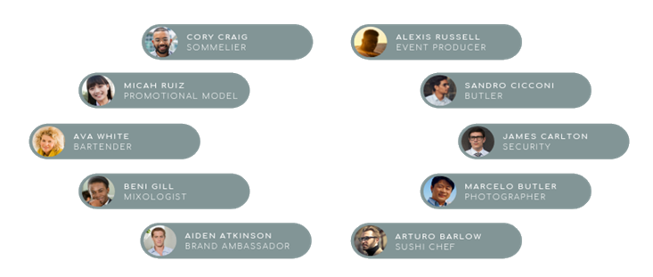

Service Providers
Notes:
Focusing on Bartenders, photographers and promotional models

Slide 7

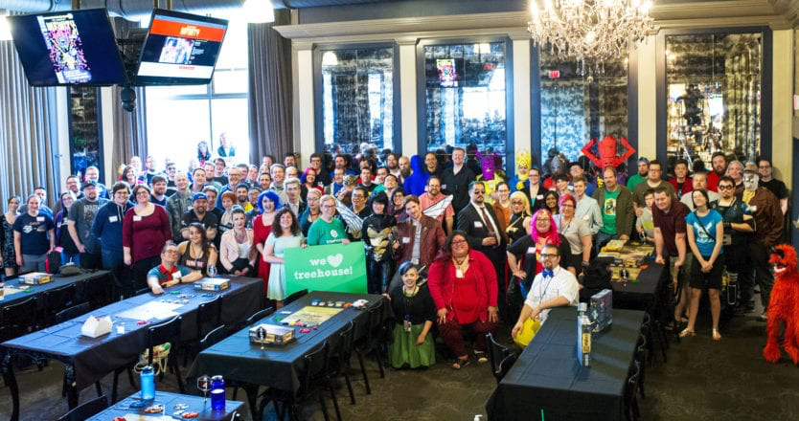
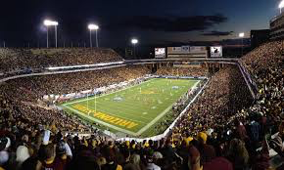






Customer Segments B2B
What do Event Managers Do?
Sporting Events
Brand Campaigns
Experiential Marketing Agencies
Fundraisers
Los Angeles
Miami
Atlanta
2020
January 2021
Mar 2022
June 2020
June 2021
Jun 2022
Las Vegas
Chicago
Notes:
Our next important element is B2B segment
Majority of EventSlay’s revenue is driven by this segment that includes event managers/decision makers in charge of organizing sporting event,s fundraisers, brand campaign..
Plan to launch in LA, Las Vegas and Miami and expand to Chicago and Atlanta by mid 2022.

Slide 8
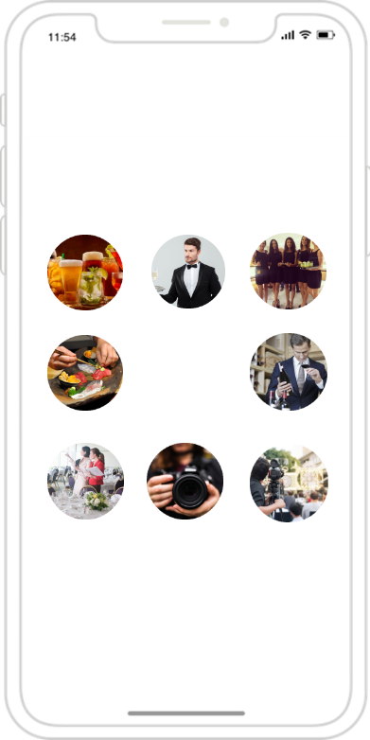
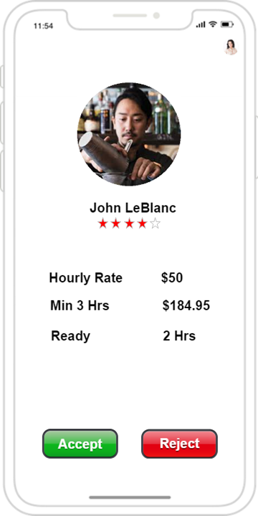

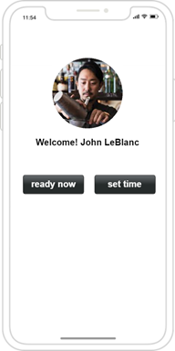
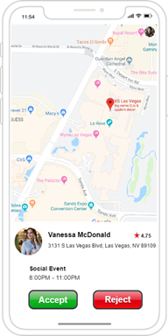
Product Overview
User Intuitive
Secured Credit Card Transaction
Advanced Matchmaking
Real-Time Location Tracking
Two-Way Ratings
Notes:
This platform will be user intuitive equipped with secured credit card transactions, real time tracking and rating system as mentioned by Ania. One of the important features to note here is the advanced matchmaking,
AI and ML driven matchmaking
EventSlay system finds a job for staff based on the following criteria
Skills (25%), Availability (25%), Location (15%), Ratings (35%)
Depending on time of the year, any special events in town, the weight of criteria dynamically changes.
For example, around Christmas, weight of availability and location will go up and the weight of ratings will go down.

Slide 9











Business Model
Subscription
Free
Monthly ($9.95)
Staff Registration
Request Staff
Find matching Staff
Pay Staff
Make payment
Payment within 3 days
No Deduction
Cost
+25% agency fee
+$9.95 processing fee
Provide event service
Staff
Customer
Notes:
To quickly illustrate our business model, here is the payment structure. Once the staff registers on the platform, there will be a mutual selection from both parties, once the services are provided, the payment will be disbursed within 72 hours. The talented staff will have a chance to subscribe for a monthly fee of $9.95 to be featured on top of the list.

Slide 10
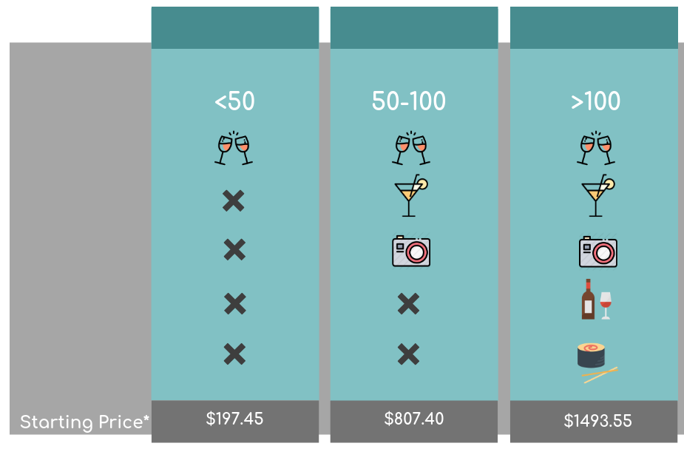
How we will make money?
PARTY IT UP
LIVE IT UP
YOLO
Number of Attendees
25% agency fee
$9.95 processing fee
$9.95 subscription fee
Bartender
Mixologist
Photographer
Sommelier
Sushi Chef
* all prices are for 3-hour minimum and include agency and processing fees
Notes:
Live life to the fullest

Slide 11

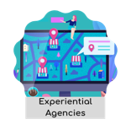



Marketing Plan

Slide 12





Competitive Analysis
On Demand Time | ✔️ | ✔️ | ❌ | ❌
Talent Selection w/photos | ✔️ | ❌ | ✔️ | ✔️
Special Instructions | ✔️ | ✔️ | ✔️ directly | ✔️
Staff Location Status | ✔️ | ✔️ | ❌ | ❌
Two-way Rating | ✔️ | ✔️ | ✔️ | ❌ one way
Background check | ✔️ | ❌ | ❌ | ✔️
Pricing | Vary per role | $21.50/hr | Varies | Varies
No Payroll Taxes | ✔️ | 18% | ✔️ | ✔️
Transaction Fees | $9.95 | 7% | ❌ | ❌
Service Fee | 25% | 15% | 10% from model | 26%
Location | CA, NV, FL | NY | Global | US, Canada, UK
Notes:
Talent selection with photos
Staff Location Status
Background check

Slide 13
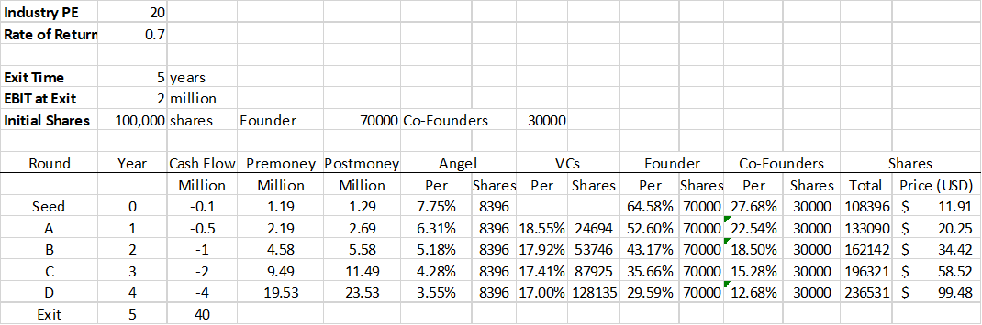
Financials

Slide 14


Together, We Slay with EventSlay!
THANK YOU! ania.puczylowska.2020@anderson.ucla.edu 305.546.3113
Notes:
So what questions do you have for us?

Slide 15
Appendix
18. US Revenue Growth
19. Key Metrics
20. Customer Acquisition Cost
21. Customer Lifetime Value for Staff
22. Use of Proceeds
23. B2B Persona
24. Financials- Key Takeaways
25. Income Statement
26. Cash Flow
27. Balance Sheet
28. Risks & Mitigations

Slide 16
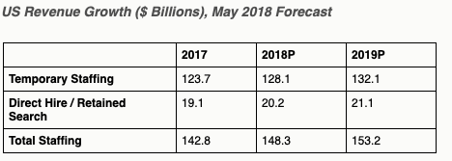
https://www2.staffingindustry.com/About/Media-Center/Press-Releases/US-Staffing-Market-to-Surpass-150-Billion-in-Revenue

Slide 17








Use of Proceeds
50
20
15
5
3
3
2
2
0%
25%
50%
75%
100%
Marketing
Legal
R&D
App Development
Licensing
Insurance
Customer Service
Recruitment

Slide 18
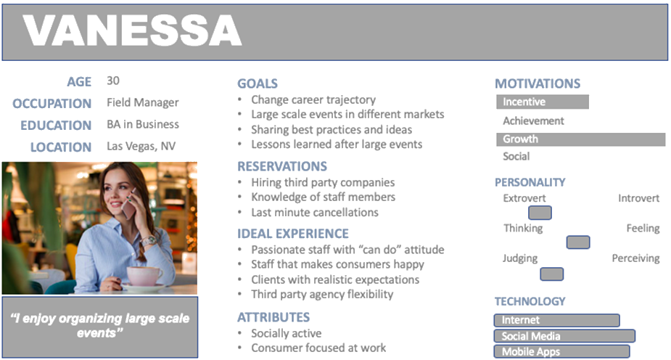
B2B Persona

Slide 19
Risks & Mitigations
Technology
Market Timing
Competition
Contractor vs Employees
Legal Counsel
Compare event industry successes and failures
Stay vigilant in acquisition and retention of clients
Invest in digital advancement
Risks
Mitigations
Notes:
Contractors vs. employees: Hire and seek legal counsel for state-specific labor requirements
Market timing: In order to manage this risk, we will find out where our current competitors have fallen short, and also timing our launch a few months before the projected demand. For ex. 3-4 Months before New Years and/or 3-4 months before Christmas in Chicago, etc
Competition: The way we plan to manage this, is by making sure to continue offering new/great services to clients and strategically acquire new customers
Technology: Periodic consultations with tech experts in upgrading digital platform would help manage this risk

Slide 20
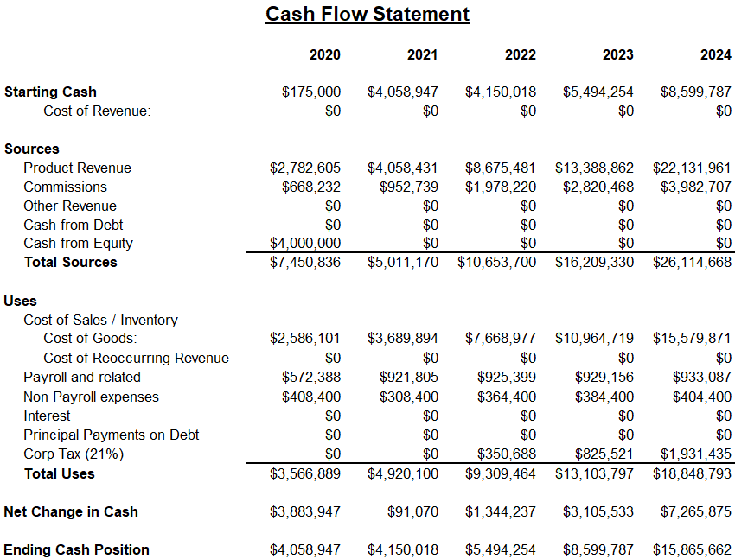
Investment Ask
$4MM
Notes:
We aresking for 4mm in october 2019 to launch 3 cities in January 2020
EventSlay team members invest $175K of personal funds - 35K per
$4MM investment ask will sustain operations for 5 years and beyond.
Provides contingency capital to cover costs associated with growth
EventSlay is projected to break even in January of 2022

Slide 21
Key Metrics
Ania
B2B $1,625
B2C $39
$16,345
$2,097
$469
Customer Lifetime Value
Photographer
Customer Lifetime Value
Promo Model
Customer Lifetime Value
Bartender
Customer Acquisition
Cost
B2B & B2C
Notes:
Base on marketing research we did its calculation for
Photographer CLV assumes 12 engagements per year with the duration of 4 hours per each engagement - subscription year 1
Promo Model CLV assumes 15 engagements per year with the duration of 3 hours per each engagement
Bartender CLV assumes 10 engagements per year with the duration of 3 hours per each engagement
CLV calculation includes subscription $9.95 per months on yearly basis
Calculation is done for year one
CAC calculation assumptions:
B2B - based on 160 B2B accounts
B2C - based on 6706 bookings of staff members for year 1
Calculated for year one after launching the business

Slide 22
Customer Acquisition Cost
Customer Segment | Annual Acquisition Cost | Notes
B2B | $1625.00 | Acquisition using media publications in the leading industry media and context advertising Facebook/AdWords Advertising + marketing + website/app development + maintenance divided by number of B2B accounts = ($150K + $100K + $10K)/160 B2B accounts
B2C (Staff) | $38.77 | Advertising + marketing + website/app development + maintenance divided by acquired bookings = ($150K + $100K + $10K)/6706 bookings = $38.77

Slide 23
CLV for Staff
CLV by Segment | Bartender 10 eng 3 hrs | Promo Model 15 eng 3 hrs | Photographer 12 eng 4 hrs
Annual Subscription | $ 119.40 | $119.40 | $119.40
Annual Margin ( M ) | $259.38 | $644.13 | $2,459.28
Retention Rate ( r ) | 50.00% | 70.00% | 85.00%
New Customer Acquisition Cost (AC) | $50 | $50 | $50
CLV=(M-c)/(1-r)-AC | $468.76 | $2,097.10 | $16,345.20

Slide 24
Financials - Key takeaways
EventSlay team members invest $175K of personal funds
$4MM investment ask will sustain operations for 5 years and beyond. Provides contingency capital to cover costs associated with growth
EventSlay is projected to break even in January of 2022

Slide 25
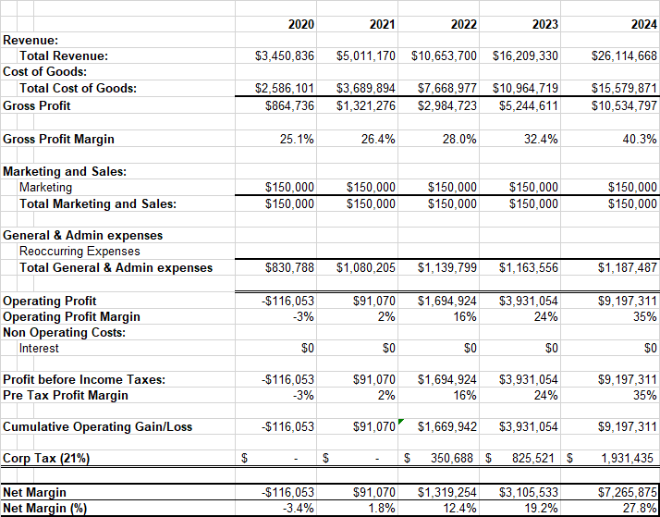
Income Statement

Slide 26
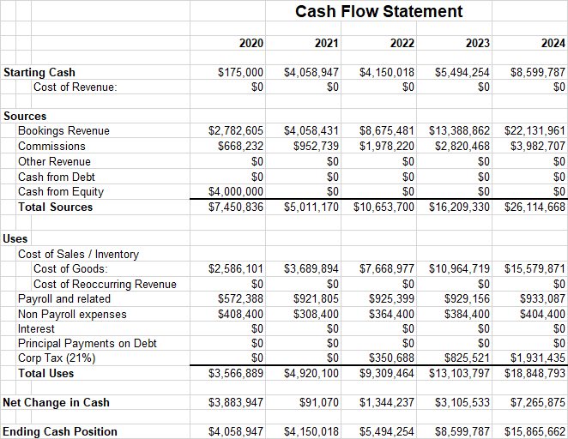
Cash Flow Statement

Slide 27
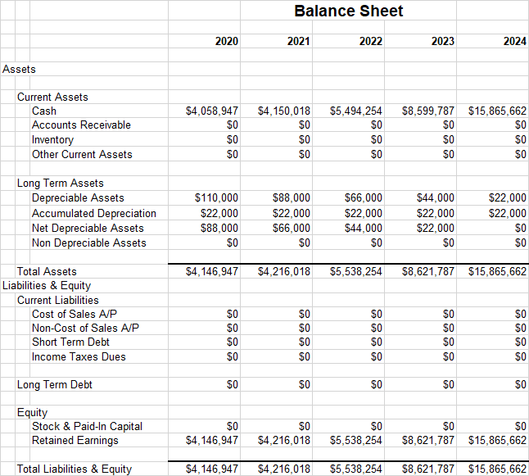
Balance Sheet

Slide 28
Financials
2020
2021
2022
2023
2024
# of subscribers
bookings
total revenue
gross margins
5,346
5,677
$3,450,836
25.1%
16,778
8,094
$5,011,170
26.4%
59,838
16,806
$10,653,700
28%
187,797
23,961
$16,209,330
32.4%
589,388
33,842
$26,114,668
40.3%
revenue
cost of revenue
operational costs
payroll
corporate tax
$2,586,101
$258,400
$572,388
-
$3,689,894
$158,400
$921,805
-
$7,668,977
$214,400
$925,399
$350,688
$10,964,719
$234,400
$929,156
$825,521
$15,579,871
$254,400
$933,087
$1,931,435
costs
net income
$(116,053)
$91,070
$1,319,254
$3,105,533
$7,265,875
Notes:
January 5th 2022 we break even as indicated started to paid corporate tax and we add two more cities
Total Revenue: hourly wages, processing fees, commission, subscription fees
Gross Margin: Everything before tax - EBIT - operating margin
Cost of revenue: wages paid to service providers (staff), credit card transaction (3%)
Operation cost: rent, general admin, lawyer, licensing (G&A)
Payroll: Employees salary

